Slide 1


KuaiRand: An Unbiased Sequential Recommendation Dataset with Randomly Exposed Videos
User Identification and Recommendation
for Shared Accounts
Chongming Gao^{1,}$†$, Shijun Li^{1,}$†$, Yuan Zhang^{2,}$†$ , Jiawei Chen³,
Biao Li², Wenqiang Lei⁴, Peng Jiang², Xiangnan He¹
¹University of Science and Technology of China; ²Kuaishou Technology Co., Ltd;
³Zhejiang University, China; ⁴Sichuan University, China; $†$Equal contribution
https://chongminggao.me | chongming.gao@gmail.com

Slide 2
Outline
Background and Motivation.
Filter Bubbles in Recommendation
Why Do we Choose the Interactive Recommendation?
Empirical Study of User Satisfaction in Filter Bubbles
Motivation of the idea
Related Works and Existing Problems
Proposed Method: CIRS
Experiments

Slide 3
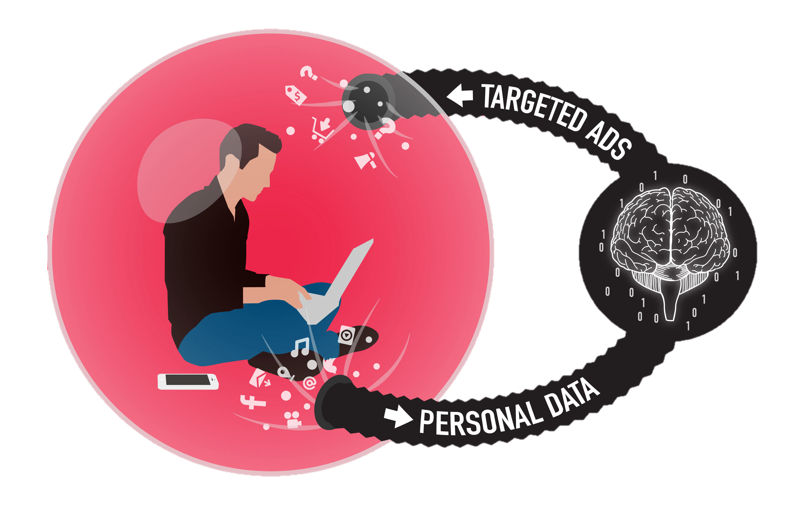
1.1 Filter Bubbles in Recommendation
Filter bubble
The phenomenon that recommender emphasizes only a small set of items in the feedback loop of the interaction process
Similar concepts: echo chamber, information cocoon
Filter bubbles in the recommendation-feedback loop

Slide 4


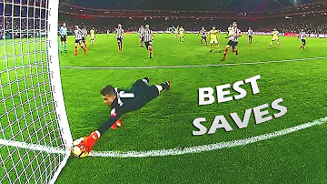





1.2 Why Interactive Recommender System (IRS)?
Because IRS is the general form of real-world recommenders (static recommender is only a special/simplified case of IRS).
Because IRS provides an environment to evaluate the effect of filter bubbles.
Recommended videos:
Sports
Games
Sports
Sports
Agent
User
An interaction trajectory in Kuaishou, a video viewing App

Slide 5
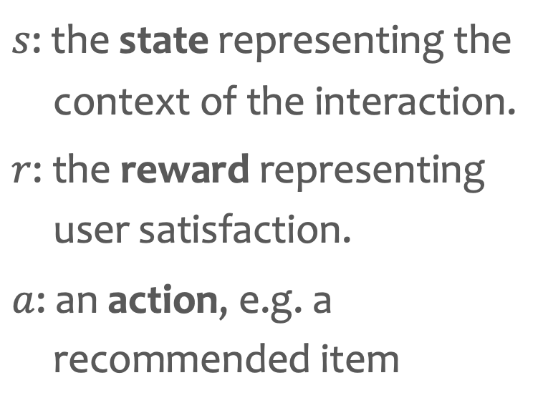
1.2 Why Interactive Recommender System (IRS)?
Because IRS is the general form of real-world recommenders (static recommender is only a special/simplified case of IRS).
Because IRS provides an environment to evaluate the effect of filter bubbles.
$s$: the state representing the context of the interaction.
$r$: the reward representing user satisfaction.
$a$: an action, e.g. a recommended item
The general framework of interactive recommendation

Slide 6

1.3 User Satisfaction in Filter Bubbles
Get bored
Assumption: Users may feel bored and give negative feedback in such a repeated and monotonous recommendation stream.

Slide 7
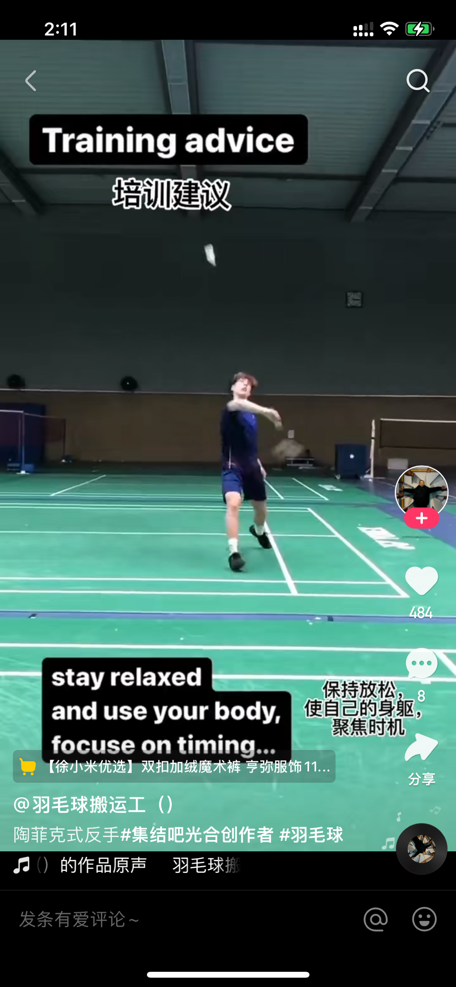




1.3 User Satisfaction in Filter Bubbles
Get bored
Assumption: Users may feel bored and give negative feedback in such a repeated and monotonous recommendation stream.
Empirical studies conducted on Kuaishou App.
Two important user behaviors reflecting satisfaction
Keeping watching until quitting or scrolling to the next one
Hitting and staying in the comments section
The recommended video stream in Kuaishou App
Metric: Watching ratio
(watching time / video video time duration)
Metric: Time staying comments section

Slide 8
1.3 User Satisfaction in Filter Bubbles
Get bored
Assumption: Users may feel bored and give negative feedback in such a repeated and monotonous recommendation stream.
Empirical study conducted on:
7176 users
3,110,886 videos
31 category tags for videos
34,215,294 views in total
August 5th – August 11st, 2020
Observation 1: User satisfaction towards a recommended item drops when the system increases the number of similar items that have the same categories with this item in recent recommendations.
Observation 2: User satisfaction towards a recommended item drops as the time interval between two similar items reduces.

Slide 9






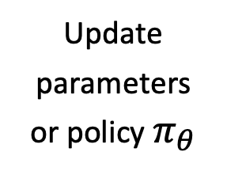
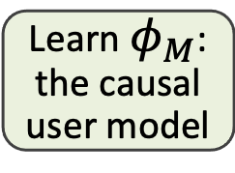
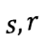
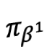
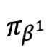
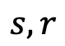
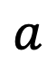
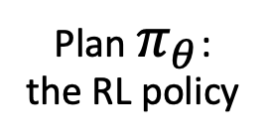
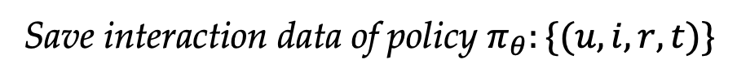
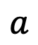
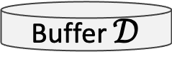
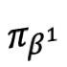
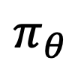
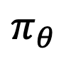
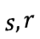
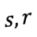
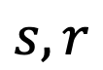
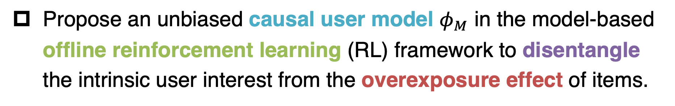
1.4 Motivation of the idea
Propose an unbiased causal user model $φ_{M}$ in the model-based offline reinforcement learning (RL) framework to disentangle the intrinsic user interest from the overexposure effect of items.
Sample data from historical policies
Training
Deployment
Buffer $𝒟$
$$s,r$$
$$s,r$$
Historical interactions
Update parameters or policy $π_{θ}$
Learn $φ_{M}$: the causal user model
$$s,r$$
Interaction
Interaction
$$s,r$$
$$s,r$$
$$π_{θ}$$
$$π_{θ}$$
Interaction
Interaction
$$a$$
Interaction
$$π_{β^{1}}$$
$$π_{β^{1}}$$
Plan $π_{θ}$: the RL policy
$$a$$
$$a$$
$$π_{β^{1}}$$
$$a$$
$$a$$
Save interaction data of policy $π_{θ}:\{(u,i,r, t)\}$
Traditional online interactive recommender
Counterfactual IRS (CIRS) based on offline RL learning

Slide 10
Outline
Background and Motivation.
Related Works and Existing Problems
Efforts to Mitigate Filter Bubbles
Causal Inference-based Recommendation
Offline Learning for Online Recommenders
Proposed Method: CIRS
Experiments

Slide 11
2.1 Efforts to Mitigating Filter Bubbles
Existing Efforts
Help users
Improve the system’s
Study on
Improve awareness of diverse social opinions (Gao et al. IUI’ 18), (Donkers et al. RecSys’ 21)
Diversity (Aridor et al, RecSys’ 20) (Tommasel et al, RecSys’ 21)
Serendipity (Xu et al. TKDD’ 20)
Fairness (Masrour et al. AAAI’ 20)
Whether the failed system can be cured by watching debunking content (Tomlein et al. RecSys’ 21 Best Paper Award)
However, these efforts mainly focus on the solutions in the static setting, where the effect of filter bubbles is hard to observe and evaluate. In addition, the rule-based policies in static setting are inflexible and hard to tackle a lot of problems.

Slide 12
2.2 Causal Inference-based Recommendation
Causal Inference (CI) has been widely used in NLP, CV, RS
Instead of exploiting the correlation between input and output, CI explicitly models the causal mechanism among variables.
General procedures (Judea Pearl, The Book of Why: The New Science of Cause and Effect)
Construct a structure causal model (SCM) to describe the causal relationship among the related variables.
Fit an unbiased model (e.g., implemented as a neural network) based on the SCM on the training data set.
In the inference stage, we actively change certain input variables (called intervention) and predict the unbiased result of the target variable.

Slide 13
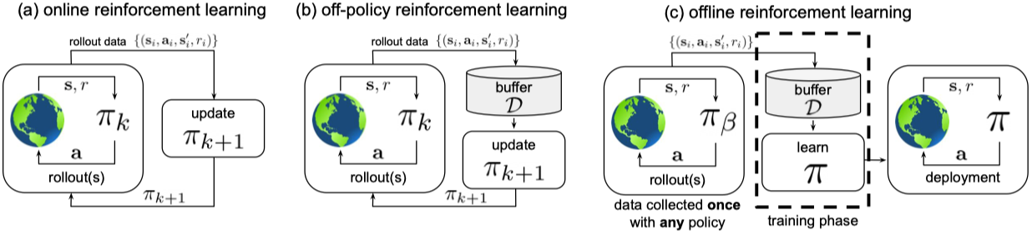
2.3 Offline Learning for Online Recommenders
Static model is inflexible. Reinforcement learning (RL) introduces a policy that has the ability to adapt to the changing environment. However, it is impractical to train RL online. Because:
for the model, the online interaction with humans is too slow.
for users, interacting with a half-baked system can hurt experiences.
Solution: Offline Reinforcement Learning.
Sergey Levine et al. 2020, Ofﬂine Reinforcement Learning: Tutorial, Review, and Perspectives on Open Problems

Slide 14
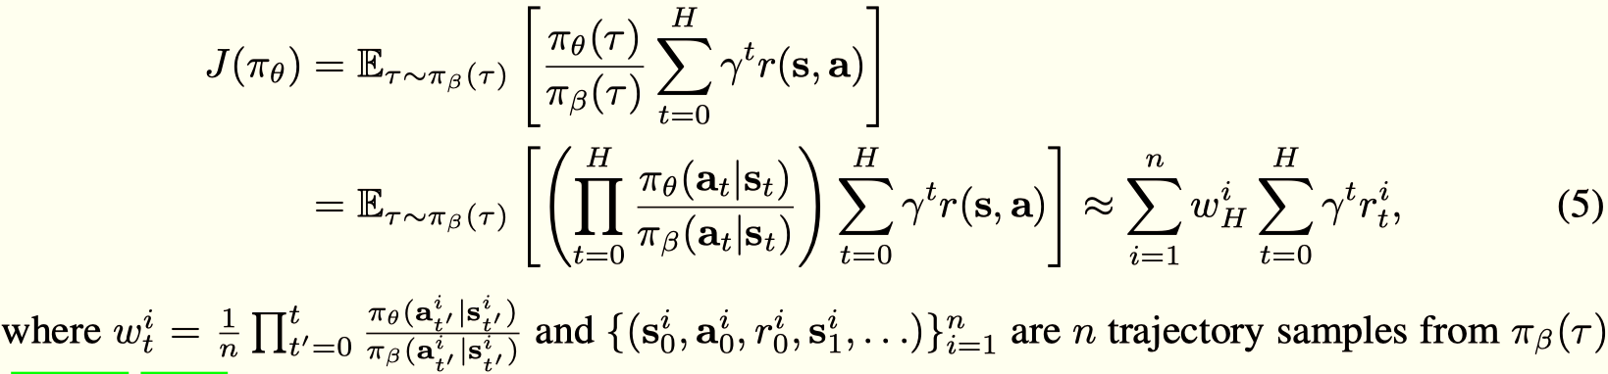
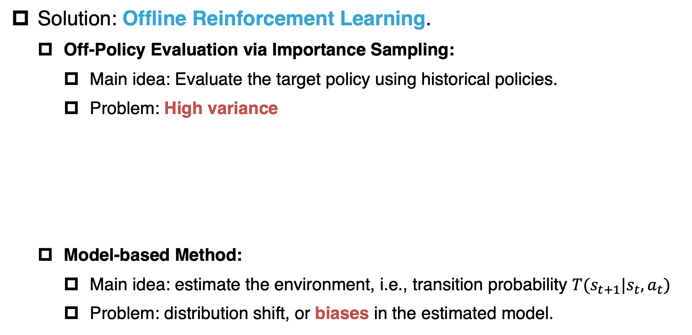
2.3 Offline Learning for Online Recommenders
Solution: Offline Reinforcement Learning.
Off-Policy Evaluation via Importance Sampling:
Main idea: Evaluate the target policy using historical policies.
Problem: High variance
Model-based Method:
Main idea: estimate the environment, i.e., transition probability $T(s_{t+1}|s_{t},a_{t})$
Problem: distribution shift, or biases in the estimated model.
Sergey Levine et al. 2020, Ofﬂine Reinforcement Learning: Tutorial, Review, and Perspectives on Open Problems

Slide 15
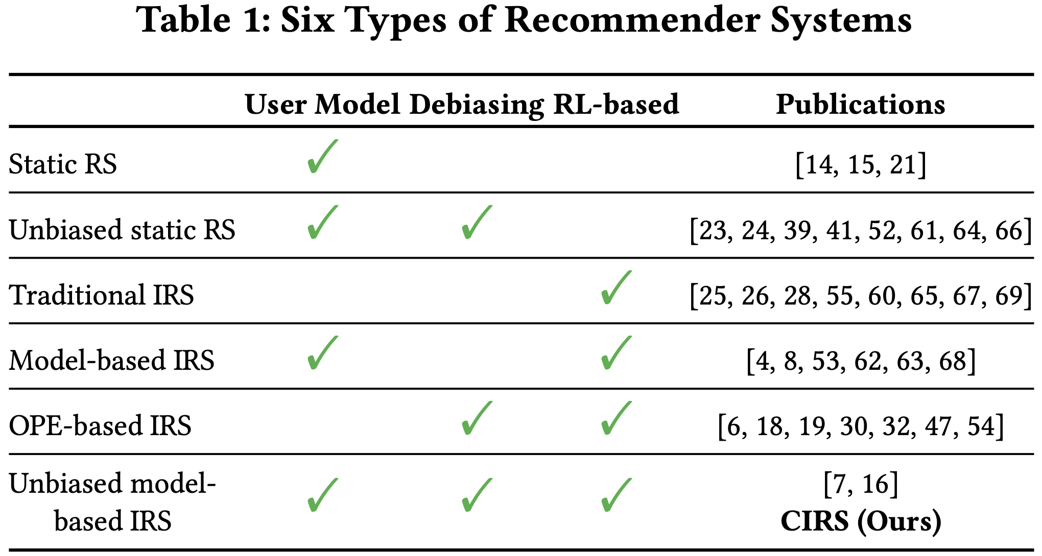
2.3 Offline Learning for Online Recommenders
Summarize RSs according to three dimensions
(1) whether the system explicitly builds a user model,
(2) whether the system considers debiasing, and
(3) whether the system has an RL-based policy.

Slide 16
Outline
Background and Motivation.
Related Works and Existing Problems
Proposed Method: CIRS
Problem Definition
Framework of CIRS
Causal Inference-based User Satisfaction Disentanglement
Experiments

Slide 17
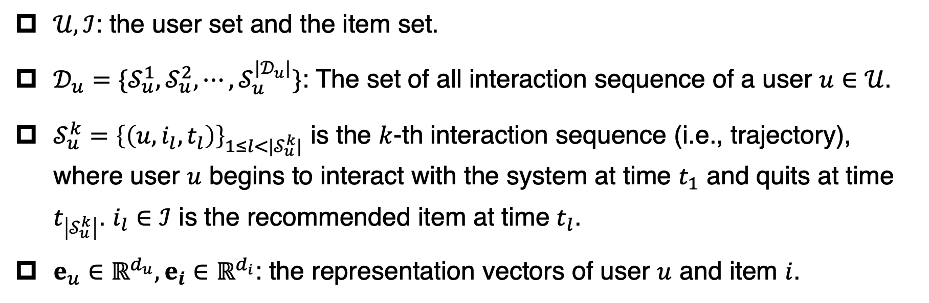
3.1 Problem Definition
Symbol Definition
$𝒰,ℐ$: the user set and the item set.
$𝒟_{u}=\{𝒮_{u}^{1},𝒮_{u}^{2},⋯,𝒮_{u}^{|𝒟_{u}|}\}$: The set of all interaction sequence of a user $u∈𝒰$.
$𝒮_{u}^{k}={\left\{\left(u,i_{l},t_{l}\right)\right\}}_{1≤l<|𝒮_{u}^{k}|}$ is the $k$-th interaction sequence (i.e., trajectory), where user $u$ begins to interact with the system at time $t_{1}$ and quits at time $t_{\left|𝒮_{u}^{k}\right|}$. $i_{l}∈ℐ$ is the recommended item at time $t_{l}$.
$e_{u}∈ℝ^{d_{u}},e_{i}∈ℝ^{d_{i}}$: the representation vectors of user $u$ and item $i$.

Slide 18
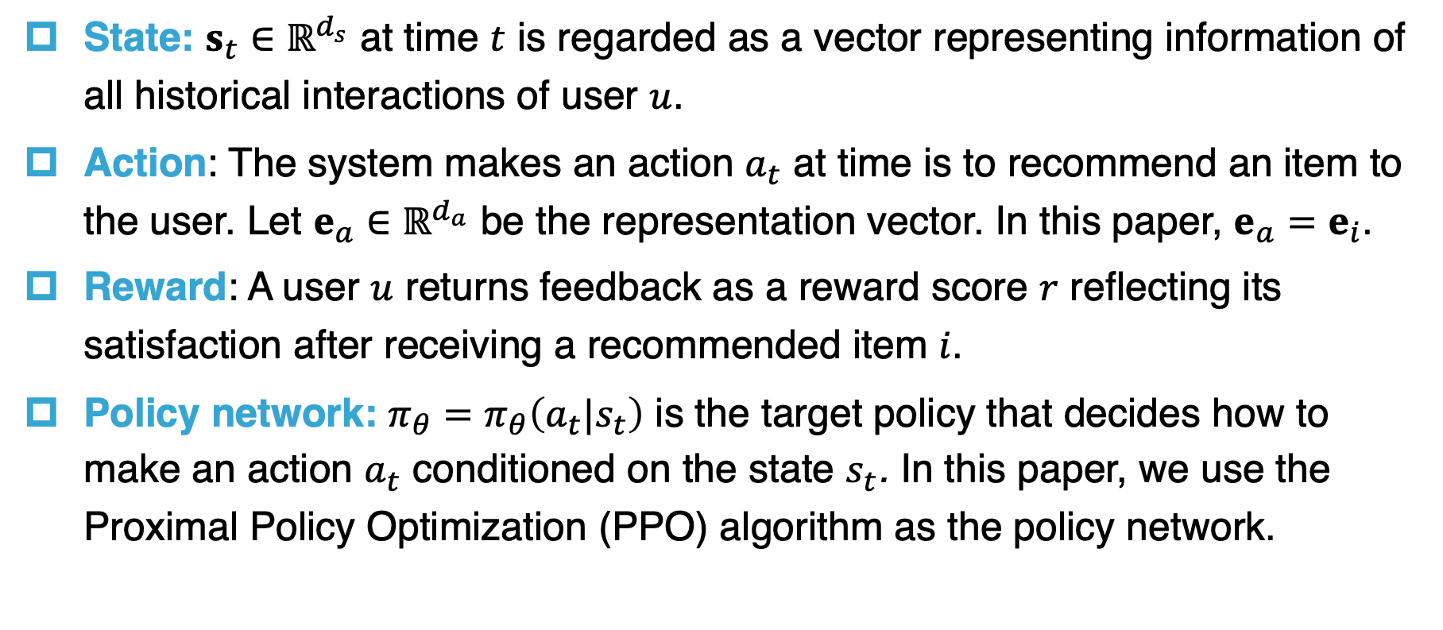
3.1 Problem Definition
Reinforcement learning problem:
State: $s_{t}∈ℝ^{d_{s}}$ at time $t$ is regarded as a vector representing information of all historical interactions of user $u$.
Action: The system makes an action $a_{t}$ at time is to recommend an item to the user. Let $e_{a}∈ℝ^{d_{a}}$ be the representation vector. In this paper, $e_{a}=e_{i}$.
Reward: A user $u$ returns feedback as a reward score $r$ reflecting its satisfaction after receiving a recommended item $i$.
Policy network: $π_{θ}=π_{θ}\left(a_{t}|s_{t}\right)$ is the target policy that decides how to make an action $a_{t}$ conditioned on the state $s_{t}$. In this paper, we use the Proximal Policy Optimization (PPO) algorithm as the policy network.

Slide 19
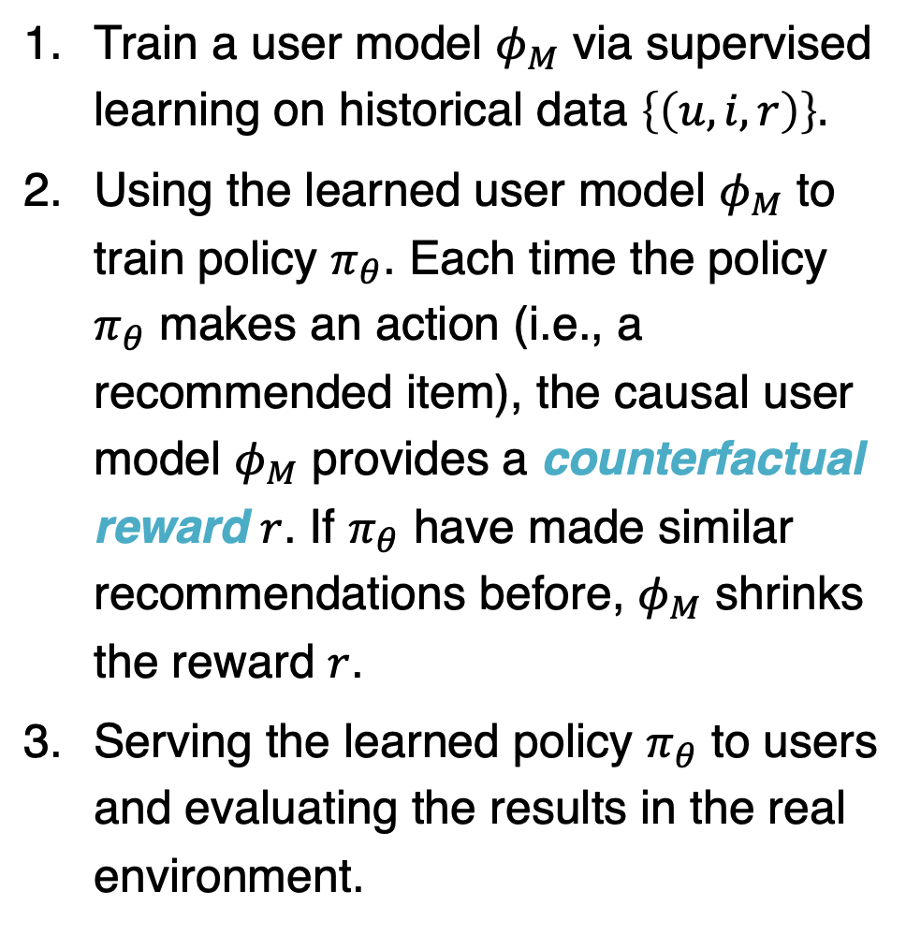
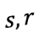
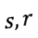
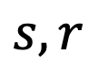
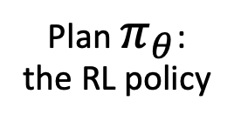
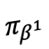
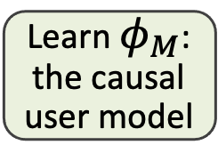
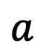
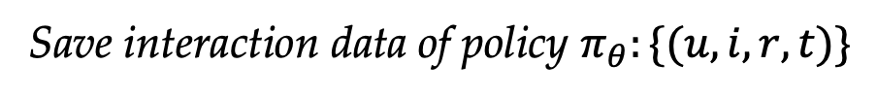
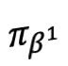
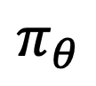
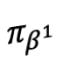
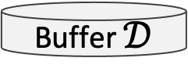
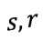
3.1 Problem Definition
Train a user model $φ_{M}$ via supervised learning on historical data $\left\{\left(u,i,r\right)\right\}.$
Using the learned user model $φ_{M}$ to train policy $π_{θ}$. Each time the policy $π_{θ}$ makes an action (i.e., a recommended item), the causal user model $φ_{M}$ provides a counterfactual reward $r$. If $π_{θ}$ have made similar recommendations before, $φ_{M}$ shrinks the reward $r$.
Serving the learned policy $π_{θ}$ to users and evaluating the results in the real environment.
The whole procedure
Sample data from historical policies
Training
Deployment
Buffer $𝒟$
$$s,r$$
Historical interactions
Learn $φ_{M}$: the causal user model
$$s,r$$
Interaction
$$s,r$$
$$s,r$$
$$π_{θ}$$
Interaction
Interaction
$$a$$
Interaction
$$π_{β^{1}}$$
$$π_{β^{1}}$$
Plan $π_{θ}$: the RL policy
$$a$$
$$π_{β^{1}}$$
$$a$$
$$a$$
Save interaction data of policy $π_{θ}:\{(u,i,r, t)\}$
Counterfactual IRS (CIRS)
based on offline RL learning

Slide 20
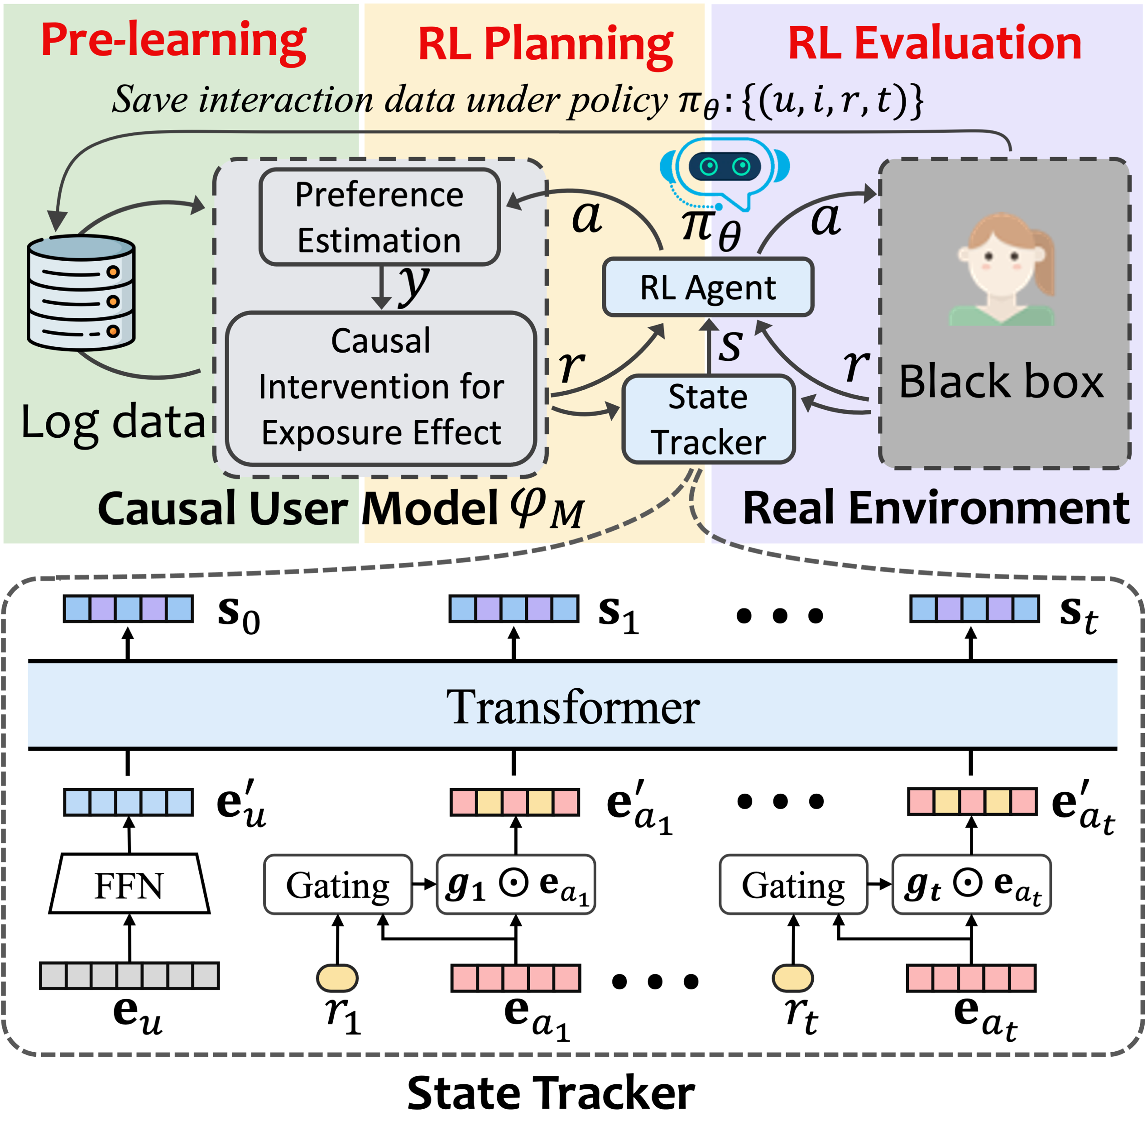
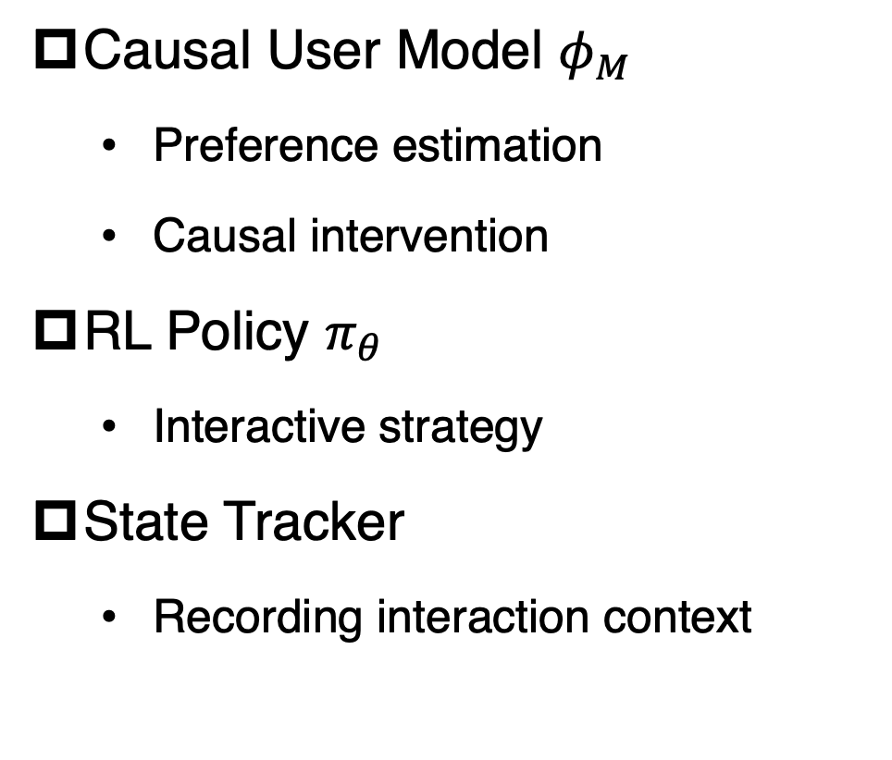
3.2 Framework of CIRS
Three modules in CIRS
Causal User Model $φ_{M}$
Preference estimation
Causal intervention
RL Policy $π_{θ}$
Interactive strategy
State Tracker
Recording interaction context

Slide 21

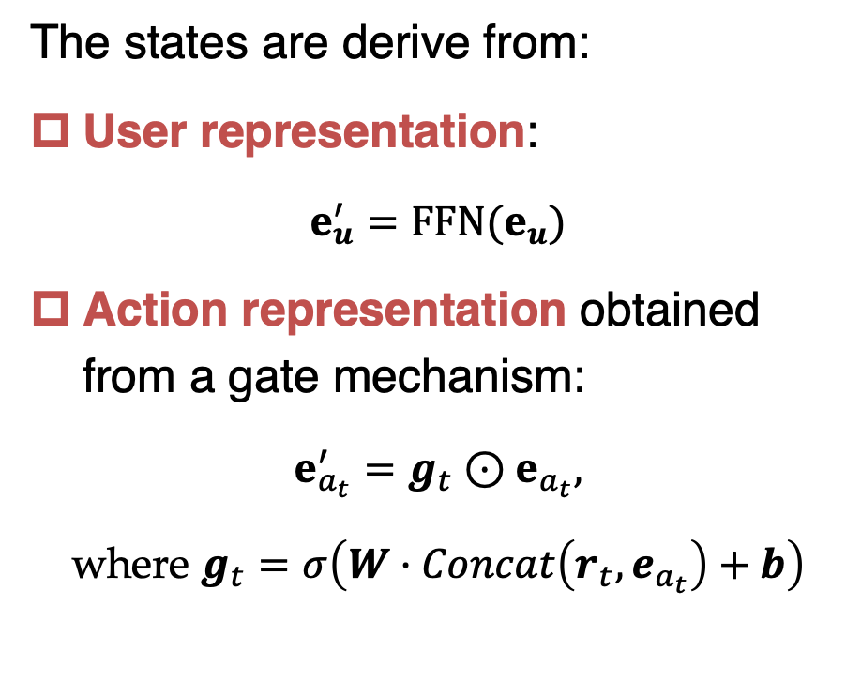
3.2 Framework of CIRS
Transformer-based State Tracker
The states are derive from:
User representation:
$$e_{u}^{′}=FFN(e_{u})$$
Action representation obtained from a gate mechanism:
$$e_{a_{t}}^{′}=g_{t}⊙e_{a_{t}},$$
where $g_{t}=σ\left(W·Concat\left(r_{t},e_{a_{t}}\right)+b\right)$

Slide 22
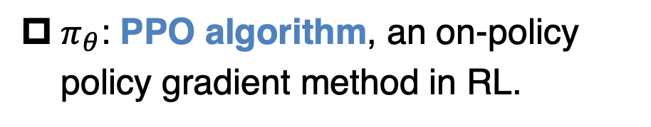
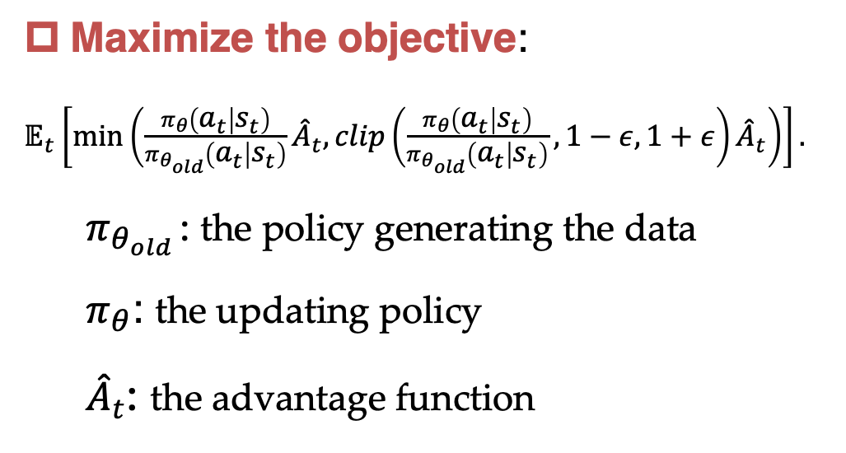
3.2 Framework of CIRS
RL-based Interactive Recommendation Policy
$π_{θ}$: PPO algorithm, an on-policy policy gradient method in RL.
Maximize the objective:
$𝔼_{t}\left[\min\left(\frac{π_{θ}\left(a_{t} | s_{t}\right)}{π_{θ_{old}}\left(a_{t} | s_{t}\right)}{\hat{A}}_{t},clip\left(\frac{π_{θ}\left(a_{t} | s_{t}\right)}{π_{θ_{old}}\left(a_{t} | s_{t}\right)},1−ε,1+ε\right){\hat{A}}_{t}\right)\right].$
$π_{θ_{old }}$: the policy generating the data
$π_{θ}$: the updating policy
${\hat{A}}_{t}$: the advantage function
Schulman et al. Proximal Policy Optimization Algorithms. arXiv:1707.06347 (2017)

Slide 23
3.2 Framework of CIRS
Causal User Model
Estimate user preference using a naive recommendation model, e.g., DeepFM.
Disentangle the intrinsic user interest from the overexposure effect of items.

Slide 24


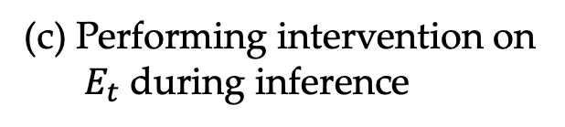









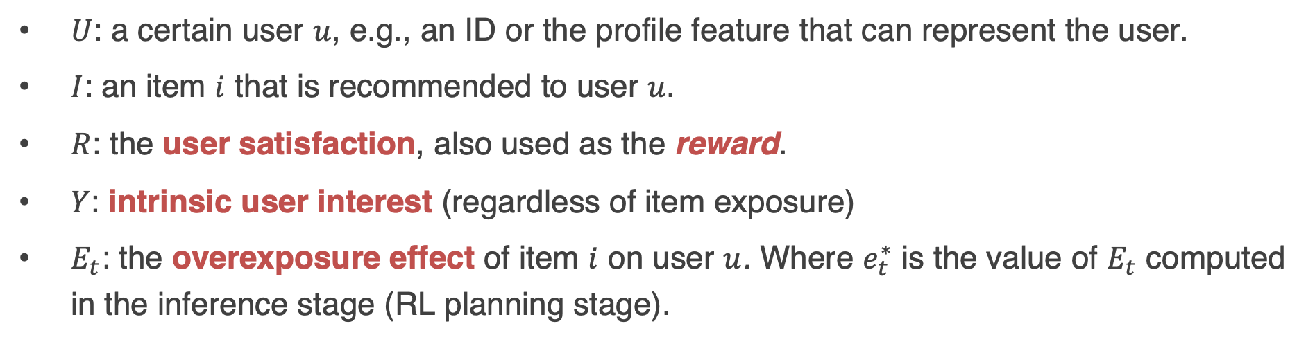



3.3 Causal Inference-based User Satisfaction Disentanglement
Structure Causal Model
$$E_{t}$$
$$E_{t}$$
$$e_{t}^{∗}$$
$$I$$
$$I$$
$$I$$
$$R$$
$$Y$$
$$R$$
$$Y$$
$$R$$
$$U$$
$$U$$
$$U$$
(a) Causal graph in traditional RSs
(b) Causal graph in our CIRS
(c) Performing intervention on $E_{t}$ during inference
$U$: a certain user $u$, e.g., an ID or the profile feature that can represent the user.
$I$: an item $i$ that is recommended to user $u$.
$R$: the user satisfaction, also used as the reward.
$Y$: intrinsic user interest (regardless of item exposure)
$E_{t}$: the overexposure effect of item $i$ on user $u$. Where $e_{t}^{∗}$ is the value of $E_{t}$ computed in the inference stage (RL planning stage).

Slide 25
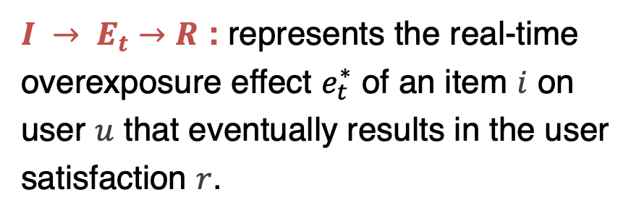

3.3 Causal Inference-based User Satisfaction Disentanglement
Structure Causal Model
$$E_{t}$$
$$E_{t}$$
$$e_{t}^{∗}$$
$$I$$
$$I$$
$$I$$
$$R$$
$$Y$$
$$R$$
$$Y$$
$$R$$
$$U$$
$$U$$
$$U$$
(a) Causal graph in traditional RSs
(b) Causal graph in our CIRS
(c) Performing intervention on $E_{t}$ during inference
Two paths in (b):
$\left(U, I\right) →Y → R$: projects user and item features into the corresponding preference ${\hat{y}}_{ui}=f_{θ}(u,i)$, which can be implemented by various recommendation models (DeepFM).
$I → E_{t}→R$ : represents the real-time overexposure effect $e_{t}^{∗}$ of an item $i$ on user $u$ that eventually results in the user satisfaction $r$.

Slide 26











3.3 Causal Inference-based User Satisfaction Disentanglement
Definition of overexposure effect $E_{t}$
$$E_{t}$$
$$I$$
$$e_{t}= e_{t}(u,i)=α_{u}β_{i} \sum_{\left\{\left(u, i_{l}, t_{l}\right)∈ S_{u}^{k}, t_{l}<t\right\}}{exp\left(− \frac{t−t_{l}}{τ} × dist\left(i,i_{l}\right)\right) }$$
$$Y$$
$$R$$
$$U$$
$𝒮_{u}^{k}={\left\{\left(u,i_{l},t_{l}\right)\right\}}_{1≤l<|𝒮_{u}^{k}|}$ is the $k$-th interaction sequence (i.e., trajectory) of user $u$.
$dist\left(i,i_{l}\right)$: is distance between two items $i$ and $i_{l}$.
$α_{u}$: represents the sensitivity of user $u$ to the overexposure effect
$β_{i}$: represents the unendurableness of item $i.$
Definition of user satisfaction ${\hat{r}}_{ui}^{t}$
Loss function in training user model:
$${\hat{r}}_{ui}^{t}=\frac{{\hat{y}}_{ui}}{1+e_{t}(u,i)}$$
$$L_{BPR}=−\sum_{\left\{\left(u, i,t\right)∈ D, j\sim p_{n}\right\}}{\log{(σ({\hat{r}}_{ui}^{t}−{\hat{r}}_{uj}^{t}))}}$$

Slide 27
3.3 Causal Inference-based User Satisfaction Disentanglement
Definition of overexposure effect $E_{t}$
$$E_{t}$$
$$I$$
$$e_{t}= e_{t}(u,i)=α_{u}β_{i} \sum_{\left\{\left(u, i_{l}, t_{l}\right)∈ S_{u}^{k}, t_{l}<t\right\}}{exp\left(− \frac{t−t_{l}}{τ} × dist\left(i,i_{l}\right)\right) }$$
$$Y$$
$$R$$
$$U$$
$𝒮_{u}^{k}={\left\{\left(u,i_{l},t_{l}\right)\right\}}_{1≤l<|𝒮_{u}^{k}|}$ is the $k$-th interaction sequence (i.e., trajectory) of user $u$.
$dist\left(i,i_{l}\right)$: is distance between two items $i$ and $i_{l}$.
$α_{u}$: represents the sensitivity of user $u$ to the overexposure effect
$β_{i}$: represents the unendurableness of item $i.$
Definition of user satisfaction ${\hat{r}}_{ui}^{t}$
Loss function in training user model:
$${\hat{r}}_{ui}^{t}=\frac{{\hat{y}}_{ui}}{1+e_{t}(u,i)}$$
$$L_{BPR}=−\sum_{\left\{\left(u, i,t\right)∈ D, j\sim p_{n}\right\}}{\log{(σ({\hat{r}}_{ui}^{t}−{\hat{r}}_{uj}^{t}))}}$$

Slide 28









3.3 Causal Inference-based User Satisfaction Disentanglement
$$E_{t}$$
$$e_{t}^{∗}$$
Causal Intervention on Overexposure Effect
$$I$$
$$Y$$
$$R$$
$$e_{t}^{∗}=γ^{∗}⋅α_{u}β_{i} \sum_{\left\{\left(u, i_{l}^{∗},t_{l}^{∗}\right)∈ S_{u}^{∗}, t_{l}^{∗}<t\right\}}{exp\left(− \frac{t−t_{l}^{∗}}{τ^{∗}} × dist\left(i,i_{l}^{∗}\right)\right) }$$
$$U$$
Variables with Asterisk$“∗”$ are these in the inference stage (i.e., RL planning stage)
Adjusted user satisfaction ${\hat{r}}_{ui}^{t∗}$
$${\hat{r}}_{ui}^{t∗}=\frac{{\hat{y}}_{ui}}{1+e_{t}^{∗}(u,i)}$$

Slide 29
Outline
Background and Motivation.
Related Works and Existing Problems
Proposed Method: CIRS
Experiments
Experimental Setup
Performance Comparison
More Analysis

Slide 30

4.1 Experimental Setup
Recommendation Environments:
1. VirtualTaobao
A benchmark RL environment for recommendation.
Created by simulating the behaviors of real users on Taobao.
A user is represented as an 88-dimensional vector $e_{u}∈{\left\{0,1\right\}}^{88}$
An item is represented as a 27-dimensional vector $e_{i}∈ℝ^{27},0≤e_{i}≤1$.
When a recommender makes an action, the environment will immediately return a reward representing the number of clicks, $r∈\{0,1,⋯,10\}$.

Slide 31

4.1 Experimental Setup
Recommendation Environments:
2. KuaiEnv

Slide 32

4.1 Experimental Setup
Exit Mechanism:

Slide 33




4.1 Experimental Setup
Evaluation metric:
Accumulated reward = $\sum_{t=1}^{T}{r_{t}}$, which requires:
High single-round reward $r_{t}$
2. Long trajectory length $T$
Find a balance

Slide 34

4.1 Experimental Setup
Baselines (Recommendation Model + Policy)
DeepFM (DeepFM + Softmax Sampling)
IPS (IPS + Softmax Sampling)
PD (PD + Softmax Sampling)
DICE (DICE + Softmax Sampling)
MLP (MLP + SoftMax Sampling)
Random
$ε$-greedy (DeepFM + $ε$-greedy)
UCB (DeepFM + UCB)
CIRS (User Model + PPO)
CIRS w/o CI （CIRS without causal inference module）

Slide 35
4.2 Results

Slide 36
4.2 Results
Insights:
CIRS achieves maximal accumulated reward.
Interestingly, in A2, increasing of the reward in each round compromises the length of trajectory in the beginning. But finds a balance in the end.
CIRS w/o CI is unstable and the performance degenerates with epoch increasing.
Random in VirtualTaobao cannot bring longer length because of curse of dimensionality.
IPS has high variance.
UCB shows the effect of E&E, but it cannot address filter bubble problem.

Slide 37
4.2 Results
Insights:
In VirtualTaobao, both policies achieve the same level of single-round performance as the static methods.
In KuaishouEnv, Armed with causal inference, CIRS beats its counterpart greatly.

Slide 38
4.2 Results
Results under different user sensitivity
Insights:
When users become more sensitive, the performance of CIRS and CIRS w/o CI drop.
Other baselines are not suitable in addressing filter bubbles.

Slide 39

4.3 Analysis
Effect of Key Parameters
$$e_{t}= e_{t}(u,i)=α_{u}β_{i} \sum_{\left\{\left(u, i_{l}, t_{l}\right)∈ S_{u}^{k}, t_{l}<t\right\}}{exp\left(− \frac{t−t_{l}}{τ} × dist\left(i,i_{l}\right)\right) }$$
Insights:
An active user is easier to get bored when viewing overexposed videos.
Popular videos are less endurable when they are overexposed.

Slide 40


4.3 Analysis
Effect of Key Parameters
$$e_{t}^{∗}=γ^{∗}⋅α_{u}β_{i} \sum_{\left\{\left(u, i_{l}^{∗},t_{l}^{∗}\right)∈ S_{u}^{∗}, t_{l}^{∗}<t\right\}}{exp\left(− \frac{t−t_{l}^{∗}}{τ^{∗}} × dist\left(i,i_{l}^{∗}\right)\right) }$$
Insights:
Suitable $(τ,τ^{∗})$ pair indeed improve the performance.
The orders of magnitude of $τ$and $τ^{∗}$are different because the unit of time is different, i.e., second(s) vs. step(s).

Slide 41
Conclusion
The first work for learning to burst filter bubbles in interactive recommendation, where filter bubbles can be observed and evaluated.
Proposed the CIRS based on offline reinforcement learning. We are the first to utilize the causal inference in interactive recommendation.
Collected a fully filled dataset (density: 100\%) from Kuaishou to create an interactive recommendation environment.
The experiments show that our proposed model can burst filter bubbles and gain the maximal accumulative rewards.

Slide 42
Thanks
Chongming Gao | 高崇铭
chongming.gao@gmail.com

